Slide 1
WELCOME

Slide 2

BHARATIDASAN ENGINEERING COLLEGE
DEPARTMENT OF MECHANICAL ENGINEERING
DOUBLE SLOPE SOLAR DISTILLATION
SYSTEM
BATCH MEMBERS:
1.PRADEEP KUMAR .P (510517114034)
2.PRASANTH .C (510517114036)
3.PRASANTH .K (510517114037)
4.RAJESH .G (510517114040)
GUIDED BY Mr.C.NATESAMURTHI,M.E.,(Ph.D.,)

Slide 3
ABSTRACT
Solar distillation is a simple experiment of converting saline water into pure portable water.
Since solar energy is a low price option, heat sourcefrom the sun is used for purification in
the present work.
In solar distillation, water is evaporated using the
irradiation from the sun and then the evaporated
water vapour is allowed to condensate as distilled
water.

Slide 4
The rate of distillate and temperatures are important factors for analyzing the solar stills.
The data associated with developed double slope solar still is presented to correlate variation of distillate output with the still basin and glass cover temperatures as well as stills with and without reflectors and PCM for different types of high TDS level water samples.
The data set of temperature and distillate output can be used to analyze the working of stills for its efficiency and effectiveness in terms of distillate yield

Slide 5
INTRODUCTION
Water is a basic need of human life for various
purposes. Potable water resources are generally
available in the form of lakes, rivers and under
ground reservoirs.
Distillation process is the cheaply available process for water purification.
The drawback of using solar still is its
productivity .The main aim is to increase
the productivity.
It is also used in deserts and in brackish
areas where pure water is not available.

Slide 6
solar distillers can be used to effectively remove
Many impurities ranging from salt to micro
Organisms and are even used to drinking water
From seawater.
The saline evaported using thermal energy and
The resulting steam is collected and condensed
As final product.
solar energy is very large , inexhaustible source
of energy. the power from the sun intercepted
by the earth is approximately 1.8 × 1011MW,
which is many thousands times larger than
the Present all commercial energy consumption
rate on the earth.

Slide 7
PRINCIPLE OF SOLAR DISTILLATION
Solar still works on the principle of solar
distillation. solar still duplicates way as
a rain water.
i.e. evaporation and condensation.
Saline water filled in the black painted basin of the solar still. this is enclosed in
a completely air tight surface.
The increases the internal temperature
of distillator causing saline water evaporate
leaving behind all of the salt contents,
bacteria viruses etc.

Slide 8
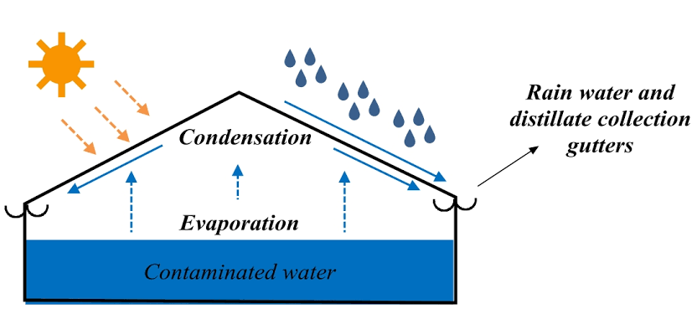

Slide 9
WORKING
A basin of solar still has a thin layer of water,
a transparent glass cover is placed over the
basin and channel for collecting the distillate
water from solar still.
The glass transmits the sun rays and saline
water in the basin is heated by solar radiation
which passes through the glass cover.
In solar still, the temperature difference
between the water and glass cover is
drinking force of pure water yield.

Slide 10
It influences the rate of evaporation from
the sun surface of the water within the
basin flowing towards the condensing
cover.
Vapour flows upwards from the basin
and condensate. This condensate water
is collected through a PVC channel.
Measuring Instruments are pyranometer,
temperature indicator, glass beaker and J
type thermocouples.
J type thermocouples are used to measure
the temperature of water which is in the
basin, inclined glass cover temperature.

Slide 11
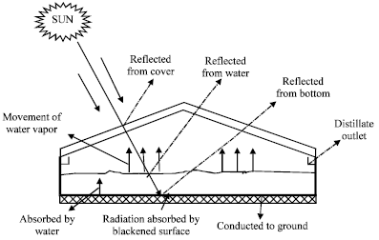

Slide 12
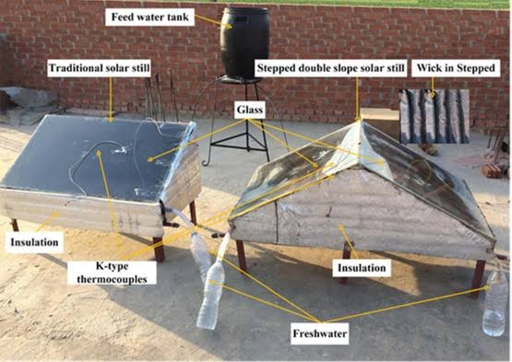

Slide 13
COMPONENTS OF SOLAR DISTILLATION
BASIN :
It is the part of the system in which the water to be distilled is kept.
Hence, it is necessary that the material has
high absorptivity or very less reflectivity
and very less transmitivity.
It is therefore essential that it must absorb solar energy.
These are the criteria for selecting the basin materials.

Slide 14
CONDANSATE CHANNEL :
It is the part of the system in which condensed water is collected.
Sheet of required dimension is first cut out, and then it is folded by using the folding machine.
BLACK LINER :
Solar radiation transmitted through transparent
cover is absorbed in the black lining.
Black bodies are good absorbers. Black paint is used as liner.

Slide 15
TRANSPARENT COVER :
Glazing glass is used and thickness of
5 mm is selected.
The use of glass is because of its inherent
property of producing greenhouse effect
inside the still.
Glass transmits over 90% of incident
radiation in the visible range.

Slide 16
INSULATION :
Thermocol / Glass-wool is used as insulator
to provide thermal resistance to the heat
transfer that takes place from the system
to the surrounding.
REFLECTOR :
Reflecting Mirror is used with one side
silver coated and is supported by
ply wood to prevent its breakage.

Slide 17
PCM :
Phase change Material is used as Paraffin Wax
which absorbs the sun radiations by changing
its phase from solid to liquid and releases the
heat when sun radiations are absent in evening
time.
ALUMINIUM SHEET :
The solar reflective aluminium sheet used in the field of solar energy has the requirements of corrosive protection and high reflectivity.

Slide 18
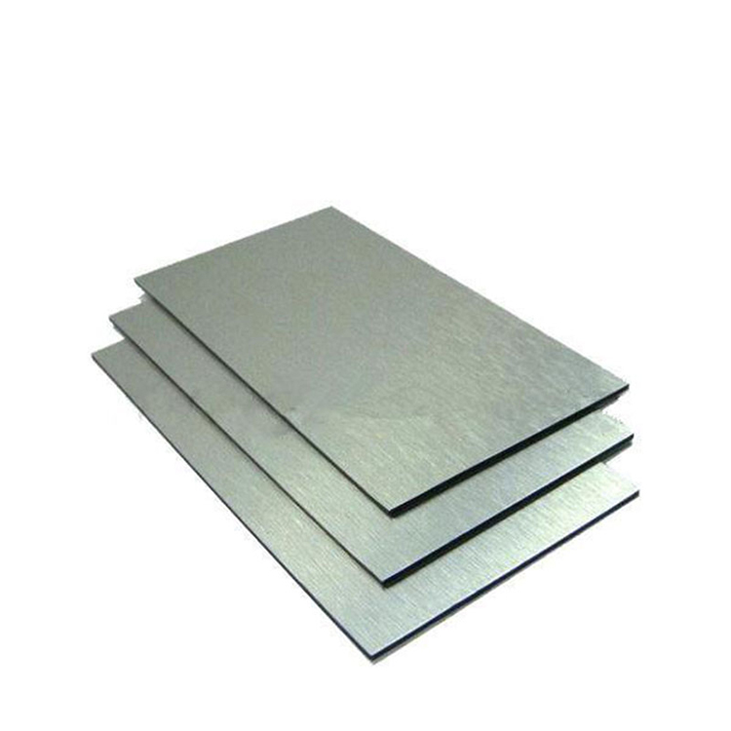
Solar reflect mirror aluminum sheet is
mainly used in outdoor use such as
solar collector photoelectric and solar
collector.
Aluminium is used because it has good thermal conductivity of 205 w/mk.

Slide 19
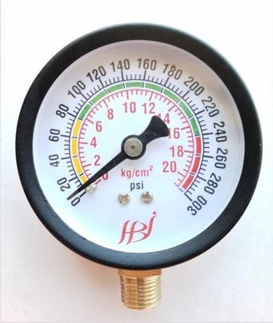
PRESSURE GAUGE :
Pressure gauge, instrument for measuring the condition of a fluid (liquid or gas) that is specified by the force that the fluid would exert, when at rest, on a unit area, such as newton per square centimeter.
It is used to measure the pressure of the fluid flow.
The tube straightens slightly under pressure to a degree measured by a pointer.

Slide 20
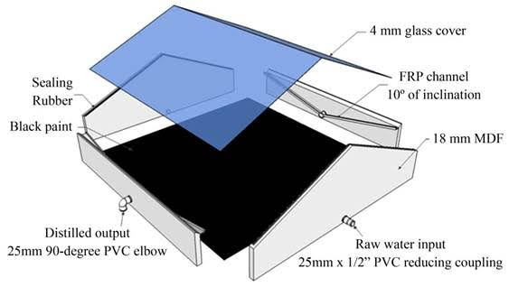

Slide 21
ADVANTAGE
Free of sun energy (during sunlight it eliminates 500watt electric consumption
per one hour of sunlight).
There are no moving parts, therefore it is
almost reliable and maintenance free.
Water taste is claimed to be better since the
device acts as a solar water vaporizer and it
does not boil the water.
Neutral Ph is claimed (rainwater).

Slide 22
DISADVANTAGE
Productivity decreases with
time variety of reason.
Leakage of vapour through
joints.
Low distilate output per unit
area.
High maintenance.

Slide 23
APPLICATION OF SOLAR ENERY
Solar Water Heating
Solar Heating of Buildings
Solar-distillation
Solar-pumping
Solar Drying of Agricultural and Animal Products
Solar Furnaces
Solar Cooking
Solar Electric Power Generation

Slide 24
FEATURE OF GOOD PURIFIER
Avoids all contamination with
last point purification.
Absolutely safe of drinking as
per WHO standards.
It should be retain natural quality
of water.
user friendly features.
long life

Slide 25
CONCLUSION
Frequent maintenance also increases
the productivity of the still.
Double slope single basin solar still
was fabricated and various tests were
conducted.
The production rate is varying with
changing the depth of basin.

Slide 26
REFERENCES
T.Elango, K.KalidasaMurugavel“The effect on water
depth on the productivity of the single slope and
double slope solar stills” Desalination 359(2015)
82-91.
Pankaj K. Srivastava,S.K.Agrawal “Experimental
and theoretical analysis of single sloped basin
type solar still consisting of multiple low
thermal inertia floating porous absorbers”
Desalination 311(2013) 198-205.

Slide 27
Margarita Castillo-Tellez,IssacPilatowshy-Figueroa,Aaron Sanchez-Juarez ”Experimental study on air velocity effect on the efficiency and fresh water production in a forced convective double slope solar still” Applied Thermal Engineering 75(2015)1192-1200.
G.N. Tiwari, S.k.Shukla and I.P.Singh,
“Computer modeling of passive/active solar
stills by using inner glass temperature”,
Desalination,154(2003) 171-185.
M.Zeroual, D.Bechki, S.Boughali“Experimental
investigation on a double slope solar still with
partially cooled condenser in the region of
Ouargla” Energy Procedia 6(2011)736-742.

Slide 28
THANK YOU

